Slide 1
NOVEMBER
2025
RuntimeTerror
Title: Eduzmena AI Assistant
PRESENTATION

Slide 2
Our Team
Mikhail Poludin — Speaker, AI Analyst
Ivan Menshikov — Backend / DB
Egor Ulianov — Frontend
Mikhail Zotov — Data Cleaning / Processing
Ekaterina Chukina — UI

Slide 3
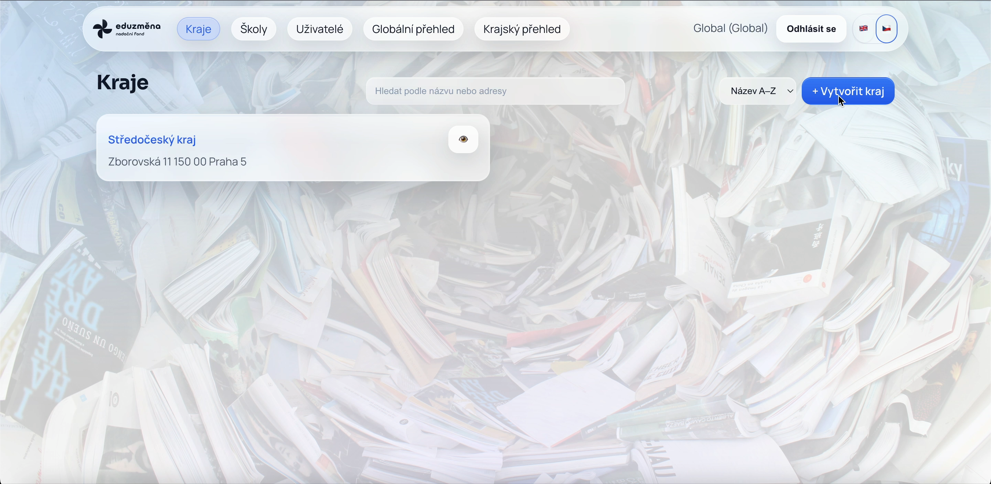
Video Demo — Region Creation

Slide 4
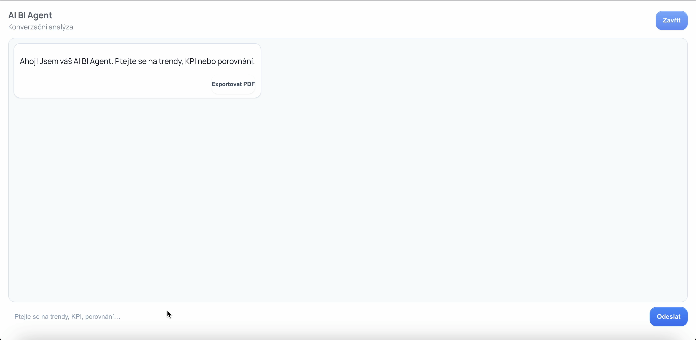
Video Demo — Data Analysis

Slide 5
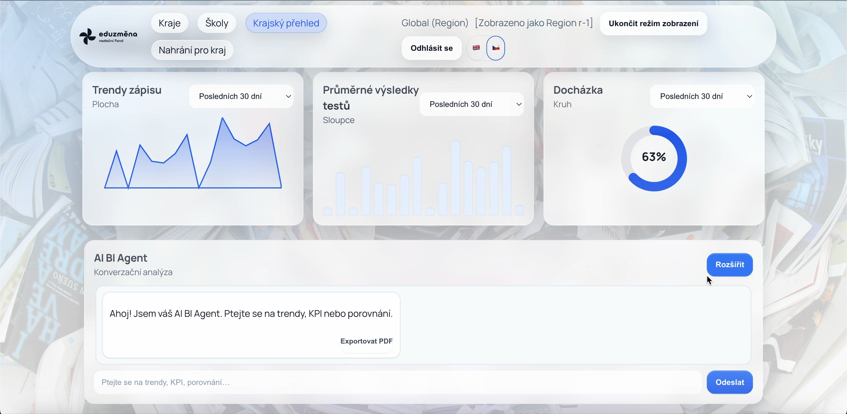
Video Demo — Data Analysis

Slide 6
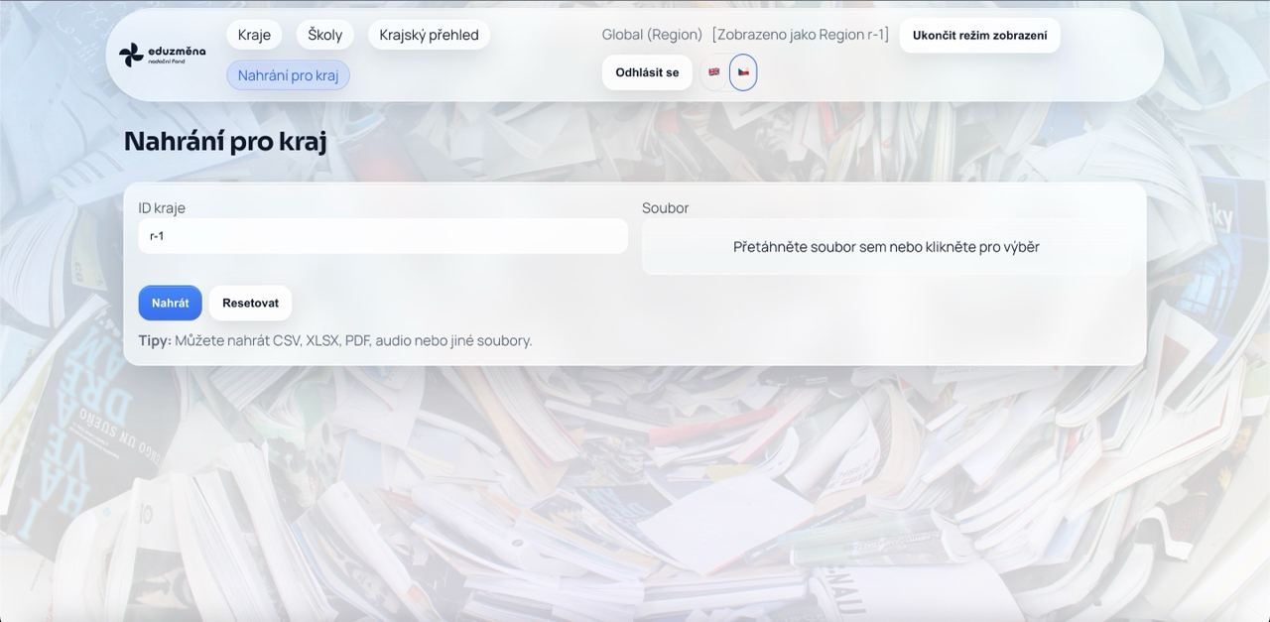
Data Upload

Slide 7
Next Steps

